Slide 1
COMP 110/L Lecture 12
Maryam Jalali Some slides adapted from Dr. Kyle Dewey

Slide 2
Outline
switch

Slide 3
switch

Slide 4
Problem
if is verbose when checking many conditions.
Notes:
Verbose = using or expressed in more words than are needed.

Slide 5
Problem
if is verbose when checking many conditions.
if (x == 5) { return “foo”;
} else if (x == 6) { return “bar”;
} else if (x == 7) { return “baz”;
} else if (x == 8) { return “blah”;
} else {
return “unknown”;
}

Slide 6
switch
switch allows for multiple == conditions to be checked
if (x == 5) { return “foo”;
} else if (x == 6) { return “bar”;
} else if (x == 7) { return “baz”;
} else if (x == 8) { return “blah”;
} else {
return “unknown”;
}

Slide 7
switch
switch allows for multiple == conditions to be checked
if (x == 5) { return “foo”;
switch (x) { case 5:
return “foo”;
} else if (x == 6){
return “bar”;
} else if (x == 7){
return “baz”;
} else if (x == 8){
case 6:
return “bar”;
case 7:
return “baz”;
case 8:
return “blah”;
} else {
return “unknown”;
}
return “blah”;
default:
return “unknown”;
}

Slide 8
Example:
SwitchBasic.java

Slide 9
switch Semantics
Look at the thing you’re switching on
Jump to the applicable case
Keep running statements until something stops you

Slide 10
switch Semantics
Look at the thing you’re switching on
Jump to the applicable case
Keep running statements until something stops you
switch (x) { case 1:
return “hi”; case 2:
System.out.println(“bye”); default:
System.out.println(“huh”);
}

Slide 11
switch Semantics
Look at the thing you’re switching on
Jump to the applicable case
Keep running statements until something stops you
switch (1) {
case 1:
return “hi”; case 2:
System.out.println(“bye”); default:
System.out.println(“huh”);
}
Notes:
-If the value we switch on is 1...

Slide 12
switch Semantics
Look at the thing you’re switching on
Jump to the applicable case
Keep running statements until something stops you
switch (1) {
case 1:
return “hi”; case 2:
System.out.println(“bye”); default:
System.out.println(“huh”);
}
Notes:
-...then jump to case 1...

Slide 13
switch Semantics
Look at the thing you’re switching on
Jump to the applicable case
Keep running statements until something stops you
switch (1) {
case 1:
return “hi”; case 2:
System.out.println(“bye”); default:
System.out.println(“huh”);
}
Notes:
-...and start executing statements from this point.

Slide 14
switch Semantics
Look at the thing you’re switching on
Jump to the applicable case
Keep running statements until something stops you
switch (1) {
case 1:
return “hi”; case 2:
System.out.println(“bye”); default:
System.out.println(“huh”);
}
Notes:
-In this case, because it’s a return, execution stops here (returning to whoever called this)

Slide 15
switch Semantics
Look at the thing you’re switching on
Jump to the applicable case
Keep running statements until something stops you
switch (3) {
case 1:
return “hi”; case 2:
System.out.println(“bye”); default:
System.out.println(“huh”);
}
Notes:
-If the value we switch on is 3...

Slide 16
switch Semantics
Look at the thing you’re switching on
Jump to the applicable case
Keep running statements until something stops you
switch (3) {
case 1:
return “hi”; case 2:
System.out.println(“bye”); default:
System.out.println(“huh”);
}
Notes:
-...then we jump to the default case, as there is no case for 3

Slide 17
switch Semantics
Look at the thing you’re switching on
Jump to the applicable case
Keep running statements until something stops you
switch (3) {
case 1:
return “hi”; case 2:
System.out.println(“bye”); default:
System.out.println(“huh”);
}
Notes:
-We would then print out “huh”...

Slide 18
switch Semantics
Look at the thing you’re switching on
Jump to the applicable case
Keep running statements until something stops you
switch (3) {
case 1:
return “hi”; case 2:
System.out.println(“bye”); default:
System.out.println(“huh”);
}
Notes:
-...and then simply trail out of the switch statement
-Whichever statement follows the switch would be executed, just as with if

Slide 19
switch Semantics
Look at the thing you’re switching on
Jump to the applicable case
Keep running statements until something stops you
switch (2) {
case 1:
return “hi”; case 2:
System.out.println(“bye”); default:
System.out.println(“huh”);
}
Notes:
-If the value we switch on is 2...

Slide 20
switch Semantics
Look at the thing you’re switching on
Jump to the applicable case
Keep running statements until something stops you
switch (2) {
case 1:
return “hi”; case 2:
System.out.println(“bye”); default:
System.out.println(“huh”);
}
Notes:
-...then we jump to the case for 2...

Slide 21
switch Semantics
Look at the thing you’re switching on
Jump to the applicable case
Keep running statements until something stops you
switch (2) {
case 1:
return “hi”; case 2:
System.out.println(“bye”); default:
System.out.println(“huh”);
}
Notes:
-...and then start executing subsequent statements.
-We’d first print “bye”...

Slide 22
switch Semantics
Look at the thing you’re switching on
Jump to the applicable case
Keep running statements until something stops you
switch (2) {
case 1:
return “hi”; case 2:
System.out.println(“bye”); default:
System.out.println(“huh”);
}
Notes:
-...but because nothing stopped us, we’d go to the next statement.
-In this case, this would mean we’d also print “huh”...

Slide 23
switch Semantics
Look at the thing you’re switching on
Jump to the applicable case
Keep running statements until something stops you
switch (2) {
case 1:
return “hi”; case 2:
System.out.println(“bye”); default:
System.out.println(“huh”);
}
Notes:
-...and then would trail out of the switch, just as before

Slide 24
Example:
SwitchFallthrough.java

Slide 25
Preventing “fall-through”
The break statement will exit out of a switch.

Slide 26
Preventing “fall-through”
The break statement will exit out of a switch.
switch (x) { case 1:
return “hi”; case 2:
System.out.println(“bye”); default:
System.out.println(“huh”);
}
Notes:
-If I take the switch from before...

Slide 27
Preventing “fall-through”
The break statement will exit out of a switch.
switch (x) { case 1:
return “hi”; case 2:
System.out.println(“bye”); break;
default: System.out.println(“huh”);
}
Notes:
-...and then throw a break in...

Slide 28
Preventing “fall-through”
The break statement will exit out of a switch.
switch (2) {
case 1:
return “hi”; case 2:
System.out.println(“bye”); break;
default: System.out.println(“huh”);
}
Notes:
-...this now behaves differently on case 2

Slide 29
Preventing “fall-through”
The break statement will exit out of a switch.
switch (2) {
case 1:
return “hi”; case 2:
System.out.println(“bye”); break;
default: System.out.println(“huh”);
}
Notes:
-We’d still jump to the case 2...

Slide 30
Preventing “fall-through”
The break statement will exit out of a switch.
switch (2) {
case 1:
return “hi”; case 2:
System.out.println(“bye”); break;
default: System.out.println(“huh”);
}
Notes:
-We’d still execute the subsequent statement (printing “bye”)...

Slide 31
Preventing “fall-through”
The break statement will exit out of a switch.
switch (2) {
case 1:
return “hi”; case 2:
System.out.println(“bye”); break;
default: System.out.println(“huh”);
}
Notes:
-...but when we reach the break, we exit out of the switch

Slide 32
Preventing “fall-through”
The break statement will exit out of a switch.
switch (2) {
case 1:
return “hi”; case 2:
System.out.println(“bye”); break;
default: System.out.println(“huh”);
}
Notes:
-...but when we reach the break, we exit out of the switch
-End result: “bye” is printed, but not “huh”

Slide 33
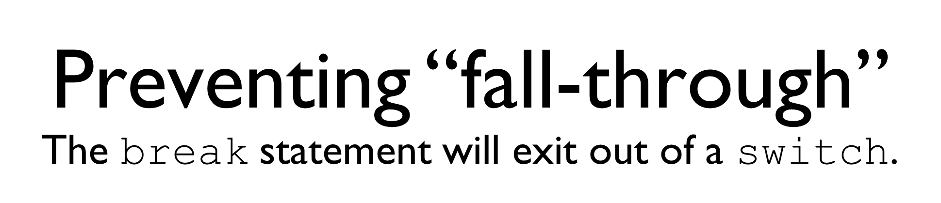
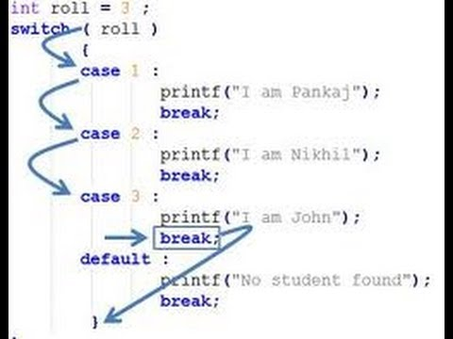

Slide 34
Example:
SwitchBreak.java

Slide 35
Some Important rules for switch statements:
Duplicate case values are not allowed.
The value for a case must be the same data type as the variable in the switch.
The value for a case must be a constant. Variables are not allowed.
The break statement is used inside the switch to terminate a statement sequence.
The break statement is optional. If omitted, execution will continue on into the next case.
A switch works with int and String.

Slide 36
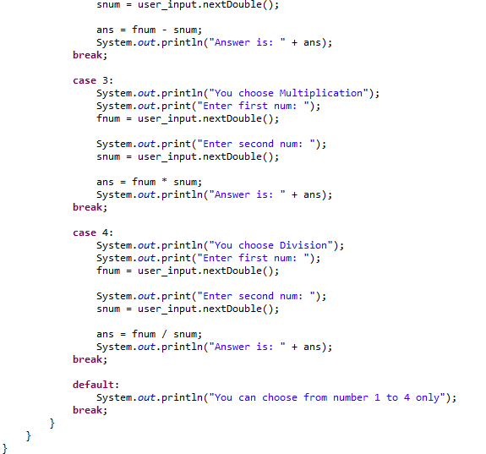

Slide 37
switch and Testing
Each case is a test candidate, as is default.

Slide 38
switch and Testing
Each case is a test candidate, as is default.
int result = 0; switch (input) { case 1:
result = result + 2; case 2:
result = result + 5; default:
result = result + 12;
}

Slide 39
switch and Testing
Each case is a test candidate, as is default.
int result = 0; switch (input) {
1 case 1:
result = result | + | 2;
case 2:
result = result | + | 5;
default:
result = result | + | 12;
}

Slide 40
switch and Testing
Each case is a test candidate, as is default.
 | int result = 0; switch (input) {
1 | case 1:
 | result = result | + | 2;
2 | case 2: result = result | + | 5;
 | default:
 | result = result | + | 12;
}

Slide 41
switch and Testing
Each case is a test candidate, as is default.
 | int result = 0; switch (input) {
1 | case 1:
 | result = result | + | 2;
2 | case 2: result = result | + | 5;
3 | default: result = result | + | 12;
}

